Slide 1
A PROJECT ON
DESIGN AND DEVELOPMENT OF A LOW COST
3-DIMENSIONAL PRINTER
BY
SHIMRAN BHATIA – 16444
SHUBHAM MISHRA – 16449
SHUBHAM PANDEY – 16450
SONI GANGWAR – 178411
UNDER THE SUPERVISION OF
PROF. Rakesh Kumar Singh
A Dissertation submitted in partial fulfillment of the requirements
For the award of the degree
BACHELOR OF TECHNOLOGY
IN
ELECTRONICS ENGINEERING
DEPARTMENT OF ELECTRONICS ENGINEERING
KAMLA NEHRU INSTITUTE OF TECHNOLOGY
SULTANPUR – UP
2019-20

Slide 2
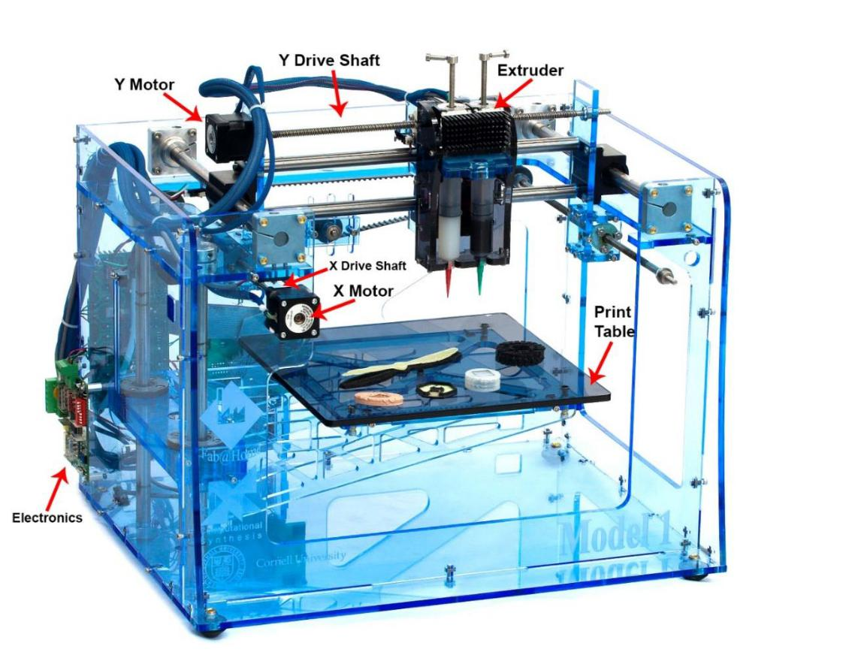
A 3-D PRINTER

Slide 3
WHAT IS A 3 DIMENSIONAL PRINTER ?
It is a machine reminiscent of the Star Trek Replicator
It can “print” in plastic, metal, nylon, and over a hundred other materials
The printed layers are thinly-sliced, horizontal cross-section of the eventual object
A 3D printer also needs to have instructions for what to print
A Computer Aided Design (CAD) file is created with the use of a 3D modeling program
Software slices the design into hundreds, or more likely thousands, of horizontal layers
These layers will be printed one atop the other until the 3D object is done

Slide 4
WHAT IS ADDITIVE MANUFACTURING ?
It refers to the technology that creates objects through sequential layering
The manufacturing process starts with a CAD file that conveys information
about how the finished product is supposed to look
The CAD file is then sent to a specialized printer where the product is created by
the repeated laying of finely powdered material (including sand, metal and glass)
and binder to gradually build the finished product
There are tremendous cost advantages to using additive manufacturing
It is a very energy efficient and environmentally friendly manufacturing option

Slide 5
PRESENT 3-D PRINTING TECHNOLOGIES
Stereo lithography (SLA)
Fused Deposition Modeling (FDM)
Selective Laser Sintering (SLS)
Selective Laser Melting (SLM)

Slide 6
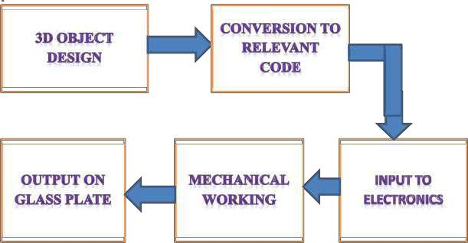
SIMPLIFIED BLOCK DIAGRAM OF THE PROJECT

Slide 7
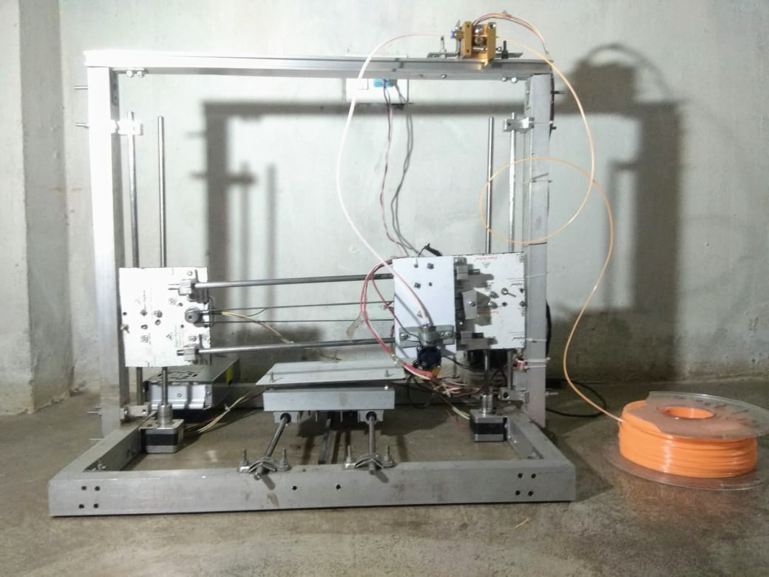
THE PRINTER

Slide 8
THE COMPONENTS USED
FRAME
EXTRUDER
STEPPER MOTOR
DRIVER A4988
PLASTICS - Acrylonitrile Butadiene Styrene (ABS)
Polylactic Acid or Polyactide (PLA)
SOFTWARE REQUIRED - Arduino Software
Repetier Software
GT2 TIMING BELT AND PULLEY
ARDUINO MEGA
RAMPS 1.4 STEPPER SHIELD
SWITCHED MODE POWER SUPPLY
ENDSTOPS
EXTRUDER FEEDER MOTOR ASSEMBLY

Slide 9
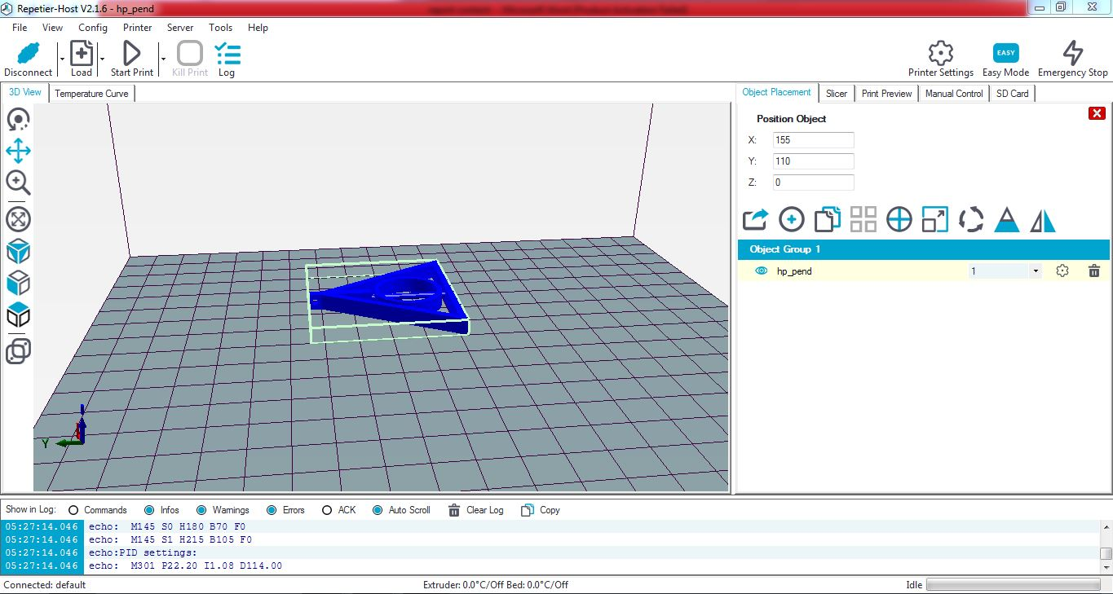
OBJECT PLACEMENT ON THE BED

Slide 10
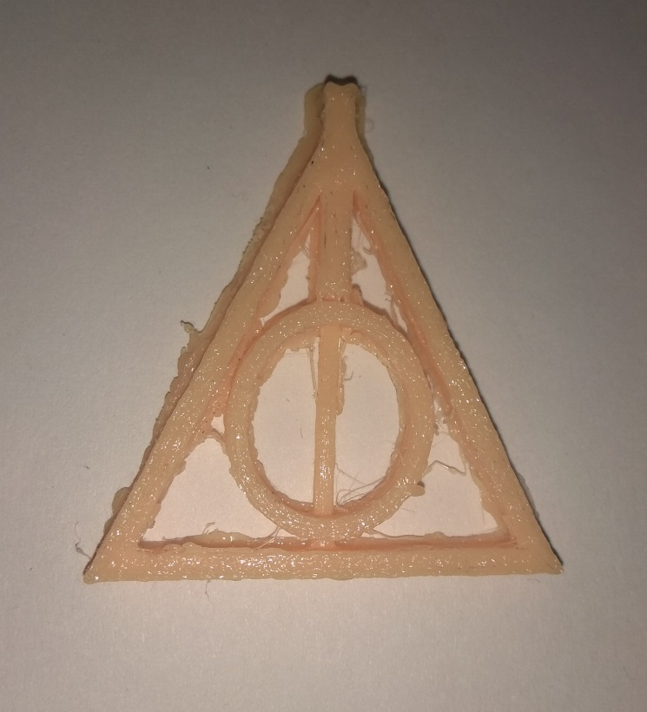
THE FINAL PRODUCT

Slide 11
Calibration, Boundary conditions and Failures
Bed-leveling
Current limiting for A4988 drivers
Z-offset measurement
Object Placement
PLA damage
Cooling for drivers
Level Shifting

Slide 12
APPLICATIONS
RAPID PROTOTYPING – A technique used to quickly fabricate a scale model
of a physical part or assembly using 3-D CAD data
MASS CUSTOMISATION – It is a method of "effectively postponing the task of
differentiating product for a specific customer until
the latest possible point in the supply network"
WEARABLES - San Francisco-based clothing company, Continuum is among the
first to create wearable, 3D printed pieces

Slide 13
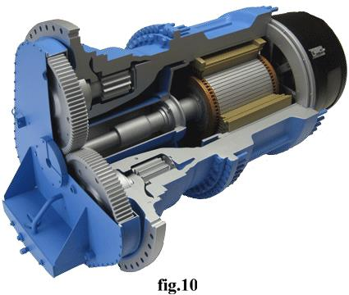
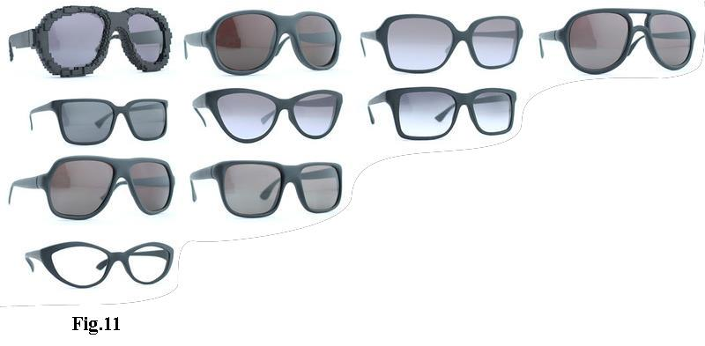
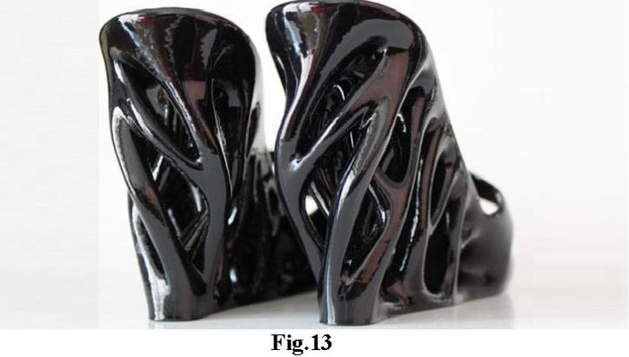
Rapid Prototyping
Mass Customization
Wearables

Slide 14
ADVANTAGES
Create anything with great geometrical complexity
Ability to personalize every product with individual customer needs
Produce products which involve great level of complexity
that simply could not be produced physically in any other way
Additive manufacturing can eliminate the need for tool production
3D printing is an energy efficient technology
Lighter and stronger products can be printed
Increased operating life for the products
Production has been brought closer to the end user or consumer
Spare parts can be printed on site which will eliminate shipping cost
Wider adoption of 3D printing would likely cause re-invention of a number
of already invented products
3D printing can create new industries and completely new professions
Printing 3D organs can revolutionarise the medical industry
Rapid prototyping causes faster product development

Slide 15
DISADVANTAGES
Since the technology is new, limited materials are available for printing.
Consumes more time for less complicated pats.
Size of printable object is limited by the movement of extruder.
In additive manufacturing previous layer has to harden before creating next layer.
Curved geometry will not be much accurate while printing.

Slide 16
CONCLUSION
As the 3D printer is a device, it should be analyzed with the
advantages and disadvantages, how the device can change the society
and engineering etc in mind
With so many potential benefits of 3D printing, there’s no surprise that
this method is making its way through a diverse number of industries and
quickly becoming a favorite tool of progressive marketers
Comparing the numerous advantages, applications and future scope,
we can conclude that the 3D printer and its technology is able to create
next industrial revolution

Slide 17
FUTURE SCOPE
Engineering in Space Station
Medicine
Concrete Buildings
Replacement Organs for the human body

Slide 18
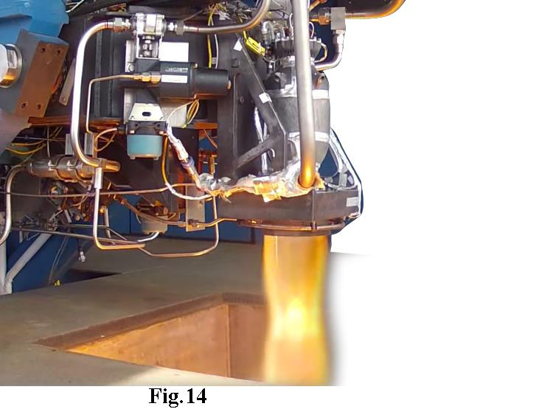
ROCKET ENGINE
NASA's first attempt at using 3D-printed parts for rocket engines has passed its
biggest, and hottest, test yet
SpaceX's Dragon capsule has been taking cargo to the International Space Station
since 2012

Slide 19
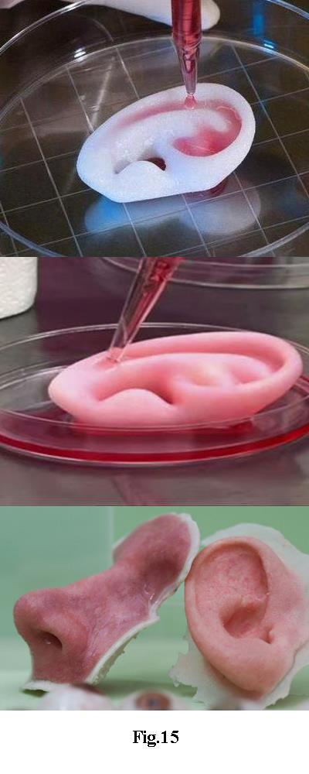
3 D BIO PRINTING
A process of generating spatially-controlled cell patterns using
3D printing technologies, where cell function and viability are
preserved within the printed construct
3D-bioprinting attributes to significant advances in the medical field
of tissue engineering by allowing for research to be done on
innovative materials called biomaterials

Slide 20
REFERENCES
Guilherme Ruggeri Pereira , Fernando Gasi ,
Sergio Ricardo Lourenco; "Review, Analysis, and Classification
of 3D Printing Literature: Types of Research and Technology
Benefits". International Journal of Advanced Engineering
Research and Science (IJAERS), Vol-6, Issue-6,
June- 2019. ISSN: 2349-6495 (P)
Chandrashekhar Kalnad; "A review on 3D Printing". International
Journal of Advanced Research in Electronics and Communication
Engineering (IJARECE), Volume 5, Issue 7, July 2016. ISSN: 2278 – 909X

Slide 21
Lalit Kumar, Qamar Tanveer, Vineet Kumar, Mohd. Javaid, Abid Haleem ;
"Developing low cost 3 D printer". International Journal of Applied Sciences and
Engineering Research, Vol. 5, Issue 6, 2016. ISSN: 2277 – 944
http://en.wikipedia.org/wiki/reprap
www.marlinfw.org
www.prusa3d.com
www.all3dp.com

Slide 22
THANK YOU

